Slide 1
Service-Oriented Scientific Collaboration Social Network
Advisor - Jia Zhang Team - 13
Bowen Zhang, Chia-Chuan Wu, Ning Du
Service Oriented Computing (18-655), Fall 2015

Slide 2
Roadmap
Introduction
Related work
System design
System implementation
Demo
Conclusions and future work

Slide 3
Introduction
Overview: We want to create a social network for scientists to show their research works with each other.
Scientists can publish own posts.
Scientists can follow other researchers.
Scientists can comment others’ posts.
Scientists can search for others and their posts

Slide 4
Related Work
Frontend:
play! - restful server
bootstrap - auto resizing
Ajax, JQuery - Asynchronous transmission
Backend:
play! - restful server
JPA - Data modeling
MySql - Database

Slide 5
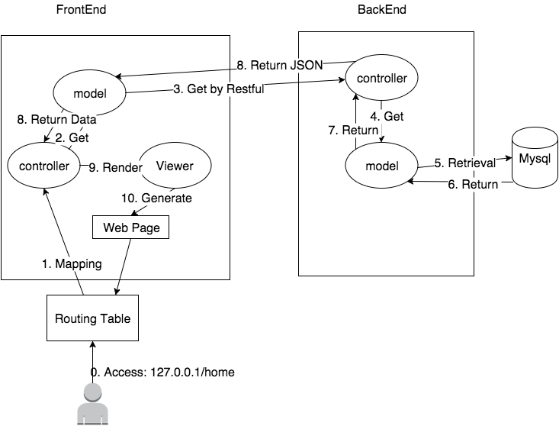
System Design

Slide 6
System Implementation
Frontend:
A user has a personal home page.
A user can sign up as a new user or login in as a returning user.
Personalized main page has user profile and posts from themselves or people they follow.
User can edit their own personal data in the front end and save it in the backend.
User can search post using a search bar at the top of the page.

Slide 7
System Implementation
Frontend:
6. User can search user by using a search page with search options including last name, first name, and research fields.
7. User can see all of his/her followers.
8. Personal home page displays posts sorted by timestamp in descending order.
9. User can post, delete, like and edit a post.
10. User can set privacy of their post as public or private.

Slide 8
System Implementation
Frontend:
11. User can comment on a post.
12. User can follow/unfollow a researcher.
13. User can share a post.
14. User get autocomplete search when searching by post.
15. User can only modify his/her own data and is prevented from modifying others’.

Slide 9
System Implementation
Frontend:
16. User can only see published post of users being followed in the main page.
17. User can share location using Google map API when publishing a post.
18. User can see a list of “People you may follow” on home page.
19. Implemented API call retry mechanism in the case of network failure to enhance fault-tolerance.

Slide 10
System Implementation
Backend:
API for posting message.
API for retrieving posts with comments.
API for updating a post.
API for deleting a post.
API for commenting on a post.
API for retrieving followers.
API for retrieving users being followed.
API for following/unfollowing a user.
API for setting security of a post.
API for retrieving user’s location.

Slide 11
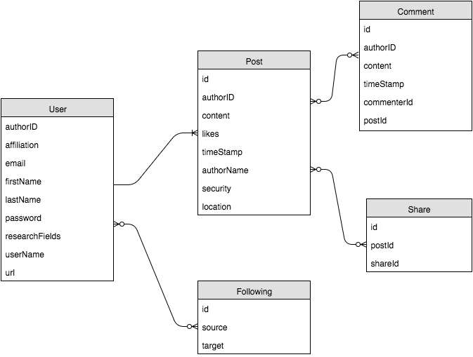
System DB Implementation

Slide 12
System Implementation
Search by Using Lucene
Allow exactly match and fuzzy match in searching
applx -> apple
Used in searching user and post
High Performance in query compare to using like %keyword% in mySQL

Slide 13
Search with Lucene
Search by Using Lucene
Problem: Lucene has state, need to be updated
MySQL
indexDB
1.update
2. update

Slide 14
Search with Lucene
Experiments: function call level
Benchmark 5000 queries for search keyword “semantic” over 1000 posts
Mysql: 15 ms/per query
Lucene:2.9 ms/per query

Slide 15
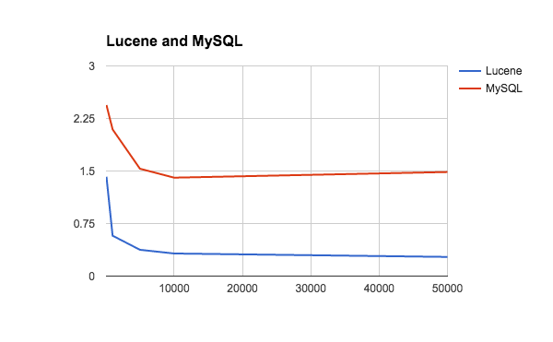
Search with Lucene
Experiments
ms
Queries

Slide 16
Search with Lucene
Experiments: Restful Service/Throughput
Lucene
MySQL
4 threads and 100 connections
Thread Stats Avg Stdev Max +/- Stdev
Latency 19.82ms 21.25ms 530.85ms 94.50%
Requests/sec: 5960.25
Transfer/sec: 10.91MB
4 threads and 100 connections
Thread Stats Avg Stdev Max +/- Stdev
Latency 169.37ms 122.00ms 704.61ms 60.07%
Requests/sec: 612.05
Transfer/sec: 3.66MB

Slide 17
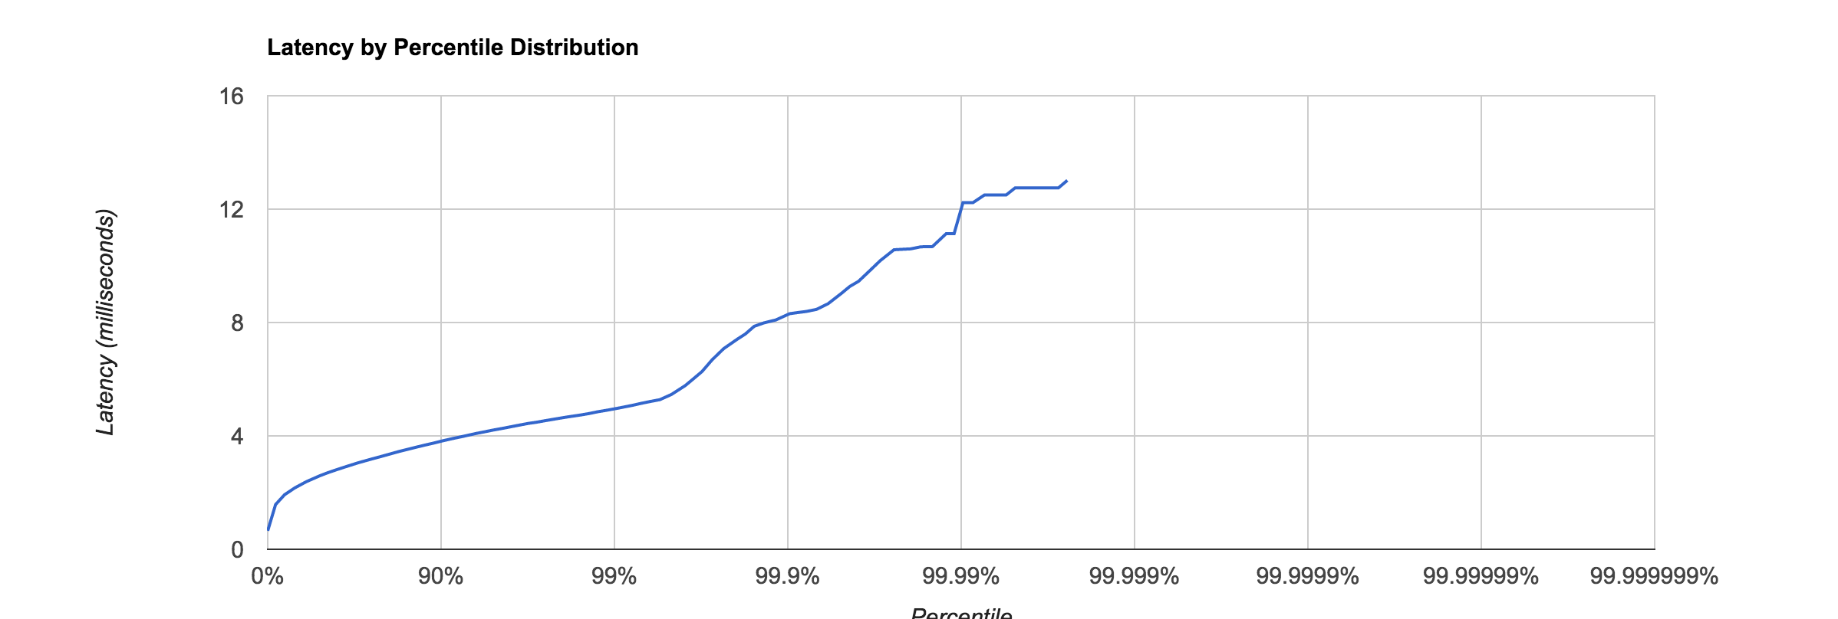
Search with Lucene
Experiments: Restful Service/response time
Lucene

Slide 18
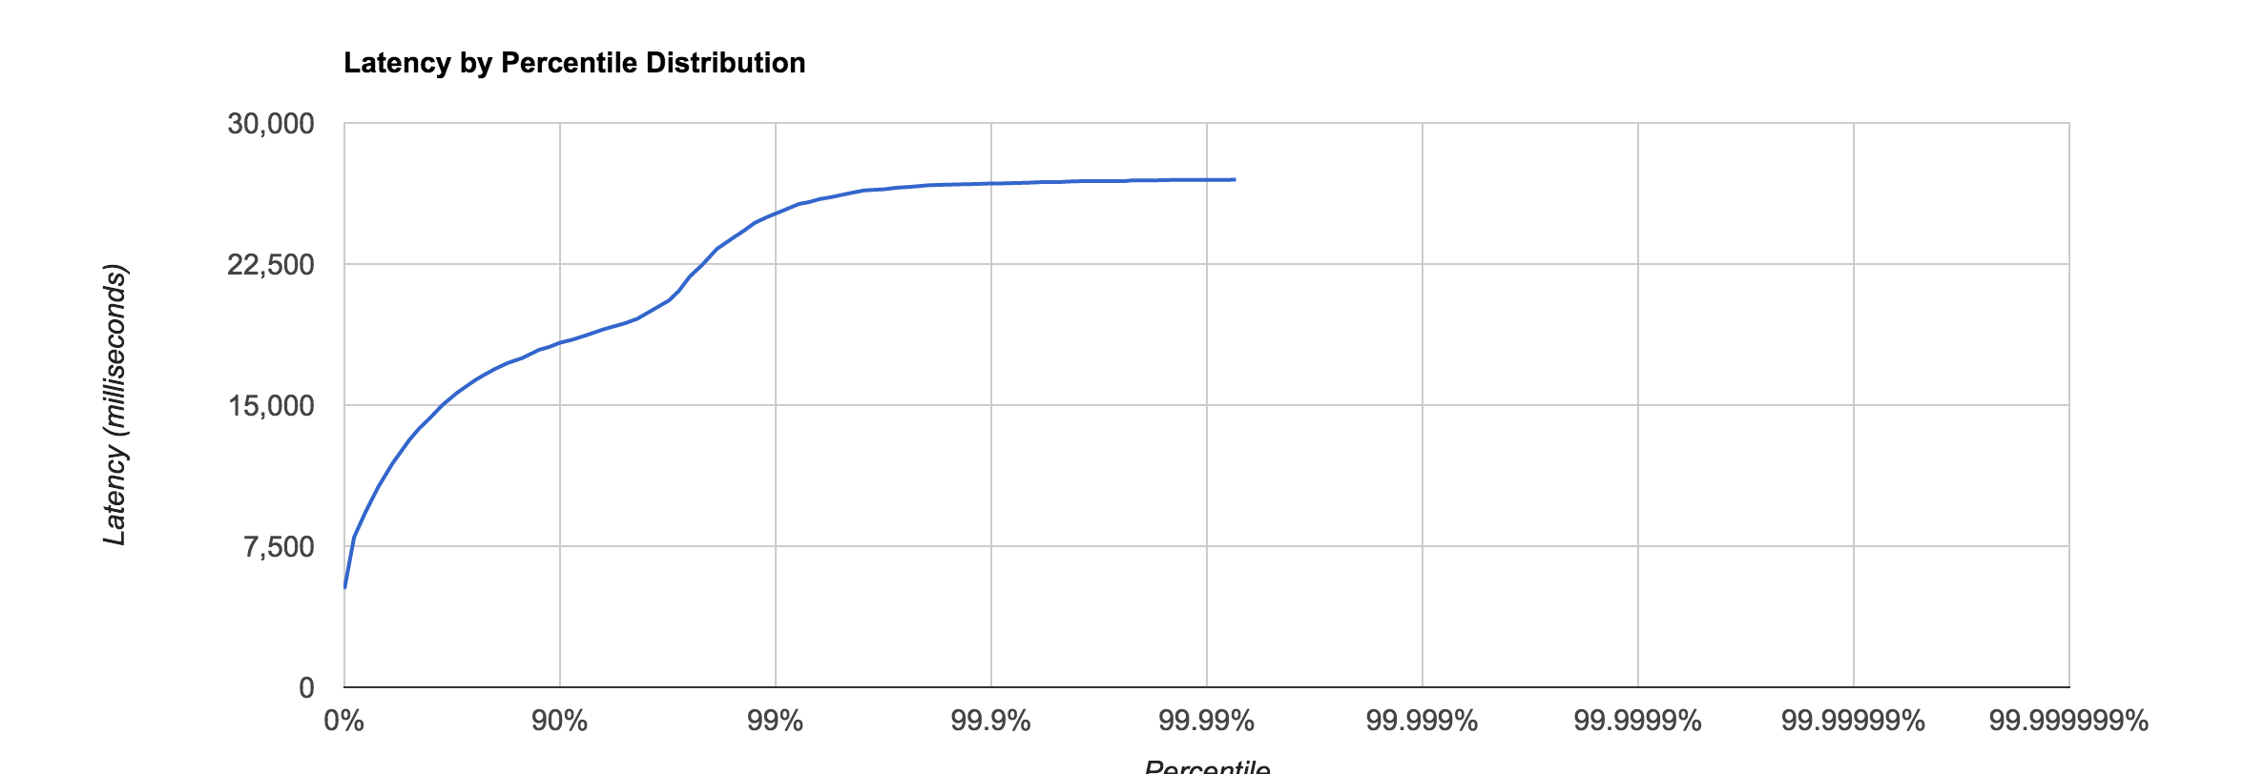
Search with Lucene
Experiments: Restful Service/response time
Mysql

Slide 19
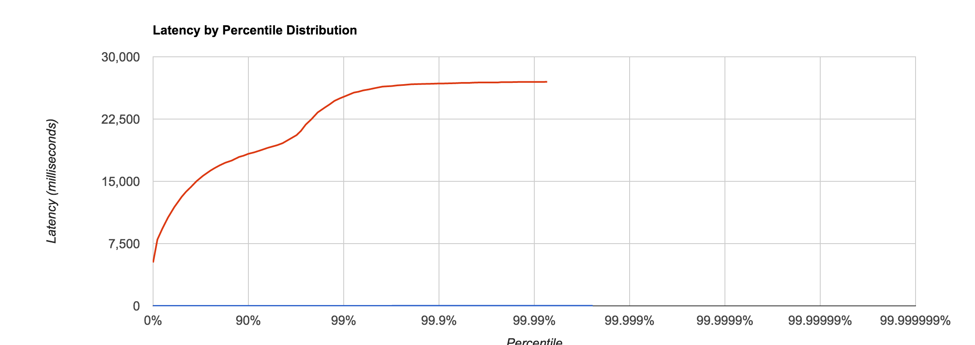
Search with Lucene
Experiments: Restful Service/response time
Lucene VS MySQL

Slide 20
Search with Lucene
Is Lucene the silver bullet?
No, lucene only store the field need to search
Ex: User’s first name, last name, research interest
To get full data of a user, query to db is still necessary.

Slide 21
REST API with authentication
Every time a user is created, the system generates a secret token associated with the user
Every time a user makes a REST call, the backend first authenticates the user with the token embedded within the request.
If the system cannot find the user associated with the token, the access is denied.
If the system finds the corresponding user, the user is authenticated and we proceed to controller methods.

Slide 22
Live Demo
Our app vs. Apache CMDA live app

Slide 23
“People You May Follow” with Spark
MapReduce: Mapper is “select .. where” and Reducer is “group by”.
Spark is a pipeline of mappers and reducers
We want to use Spark’s ML library to cluster our users into different groups.
However, how do we do this without installing a Spark cluster?

Slide 24
“People You May Follow” implementation
Inspired by Spark unit testing, we only want to incorporate the modules we need.
We decoupled the spark core and mllib modules from the main Spark package and put them into our app.
We decoupled the machine learning job from the main app by running a KMeans clustering background thread using Spark every 5 minutes.

Slide 25
“People You May Follow” optimization
Since K-means algorithm is iterative, we want to cache intermediate results.
However, calling cache() in spark only stores the RDD in memory. We want to persist results in disk when being evicted from memory.
We used “Persist(StorageLevel.MEMORY_AND_DISK_SER)” because evicting a serialized block is a lot cheaper than evicting a non-serialized block.

Slide 26
Fault-tolerance in case of network failure
When there is a sudden network communication failure, our frontend will retry the request for a certain amount of time.
When the backend is shut down for upgrade or other reasons, the same mechanism applies.
This ensures minimal user disruption in the event of transient network failure.

Slide 27
Future Works
Improvement
We want to add authorization layer on top of REST authentication.
We would like to reduce the number of round-trips to DB by creating additional classes to serialize complicated objects. We can also load data on-demand.
Good Wish
High Availability: introducing redundancies to remove single point of failure. Example: load balancing between machines.
Distributed Cache: independent cache server to improve DB performance with concurrent read and concurrent write.

Slide 28
Conclusion
The only way to be truly satisfied with your work is to realize you are doing great work. And the only way to do great work is to love what you do.

Slide 29

Questions?

